Slide 1
Online Library Management System
Final Project Presentation on
CSCE 5430.004 - Software Engineering

Slide 2
Team Name: Penguins
Team Members:
Ashraf Syed - 11618668
Padmini Kuchukulla - 11605145
Abhijith Reddy Mandagiri - 11603247
Deepna Thalanki - 11644830
Raghu Vamsi Kondapalli - 11663360
Vamsi Venkat Manepalli - 11656561
Sai Vishwak Jadala - 11673439

Slide 3
Project phases:
Deliverable 1 – Proposal
Arrangement and Needs Gathering
Define the project's goals and scope, then do market research to find prospective rivals and user demands.
Deliverable 2 – Requirements Specifications
System Architecture and Design
Create the database schema and the overall system architecture.
Determine any possible hazards or difficulties, then create mitigation methods.
Deliverable 3 – Project Phase 1
Construction and testing
Utilize an agile and iterative development process to create the software.
Testing should be done at every stage of development to guarantee functionality and quality

Slide 4
Project phases :
Deliverable 4 – Project Phase 2
Release and Deployment
Install the system in a live environment.
To find any problems, carry out a soft launch with a limited set of users.
Make any updates or bug fixes required.
Deliverable 5 – project phase 3
Preservation and Assistance
Provide regular support and upkeep to ensure the system is functioning and up to date by keeping an eye on system performance and addressing any issues that may emerge.
Obtain user feedback to pinpoint areas that could be improved.
Based on user requirements and new technological developments, plan future updates or additions.

Slide 5
Responsibilities
Each Team Member’s Responsibilities:
Ashraf Syed - Oversaw project planning, coordination, and code implementation and execution.
Padmini Kuchukulla - Analyzed user requirements and developed system specifications and interfaces for the user.
Abhijith Reddy Mandagiri - Created user interface and experience design.
Deepna Thalanki - Worked on the communication between frontend and backend
Raghu Vamsi Kondapalli - Developed the server-side of the web application
Vamsi Venkat Manepalli - Designed and maintained the database and the tables used by the web application.
Sai Vishwak Jadala - Performed system testing and unit testing on the project for easy user experience.

Slide 6
Abstract
This is a web-based online system, developed for computerizing all library activities.
The system mainly focuses on basic library operations, such as
○ Add new book
○ Automatic categorization of book
○ Search book
○ Issue book
○ Return book
○ Check the availability of book
Developed with the help of Django framework and postgreSQL database.

Slide 7
Introduction
➢ It is basically updating manual library system into an internet based application.
➢ It assists both student and staff of library in borrowing and supervising the books, respectively
➢ This system is developed to help the students as well as staff of library to maintain the library in the best way possible and also reduce the human efforts.

Slide 8
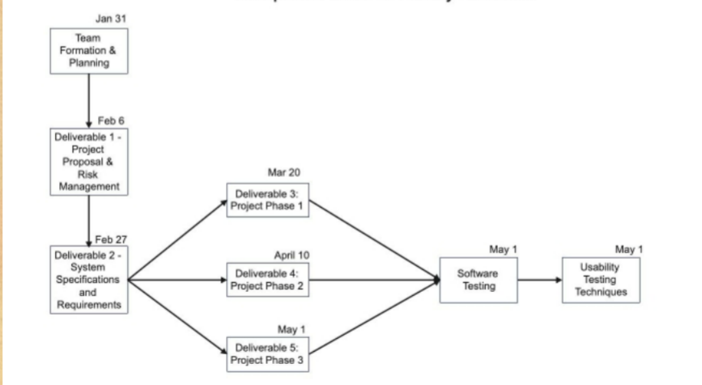
Project Plan

Slide 9
Objectives
➢ Distinct product users based on their roles and permissions
○ Admin
○ Student
➢ Authentication of users at their login
➢ Provide interface to add or issue books and view registered students for staff
➢ Status page for students to view the books borrowed by them
➢ Facility to search books based on voice
➢ Automatic categorization of books in genres based on title

Slide 10
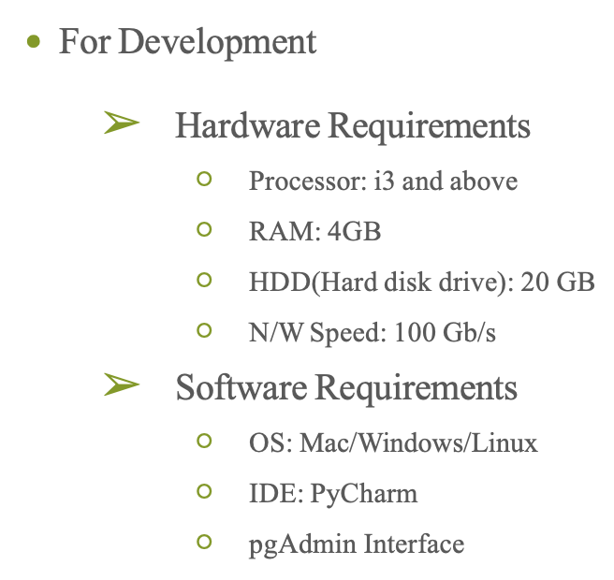
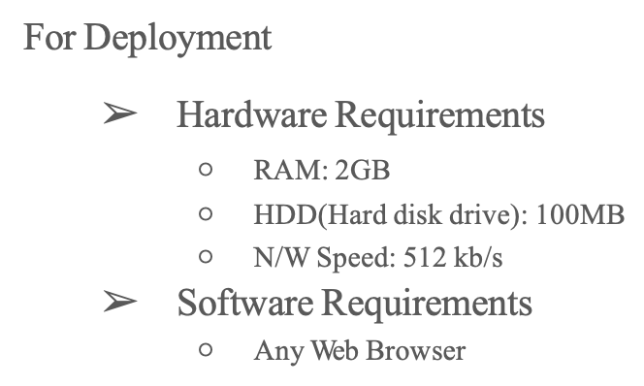
SYSTEM REQUIREMENTS

Slide 11
Scope
➢ As all manual work is now computerized and also system categorizes the book by itself, Librarian no longer needs the knowledge of genres of all books. Hence, workload is decreased.
➢ All educational institutions can make use of this system to manage their books and it’s transactions.
➢ This project can be further extended by adding the facility for students to reserve a book in advance.

Slide 12
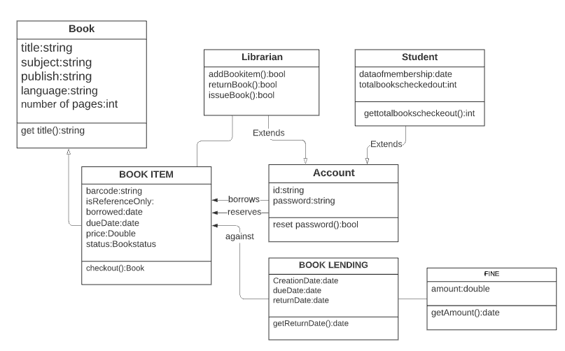
UML Diagrams (1)
Class Diagram

Slide 13
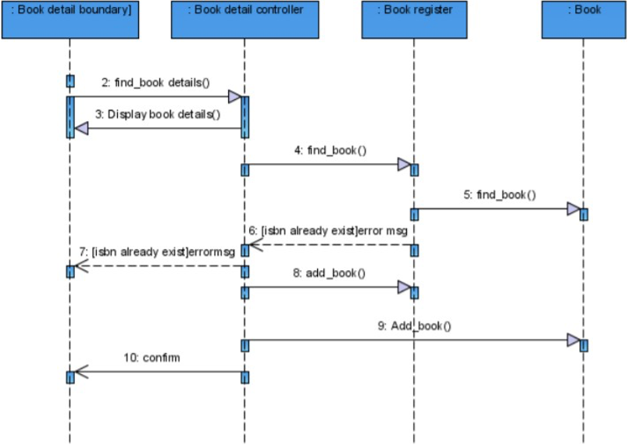
UML Diagrams (2)
Handle Book

Slide 14
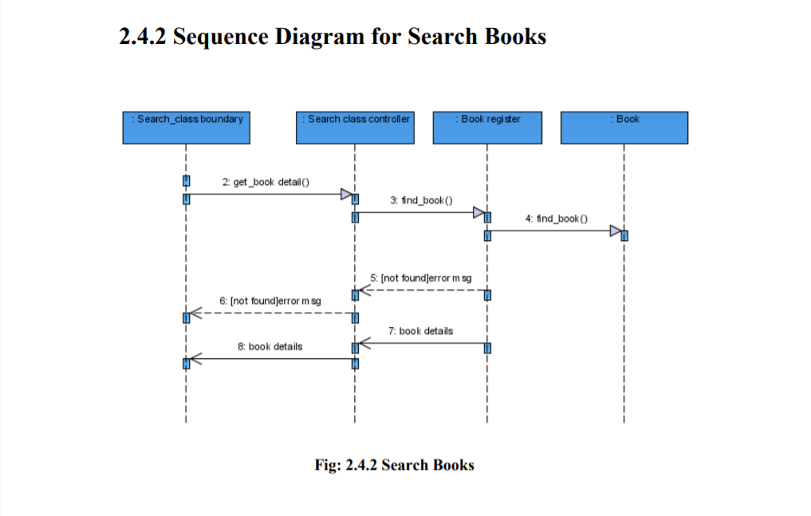
UML Diagrams (3)
Search Book

Slide 15
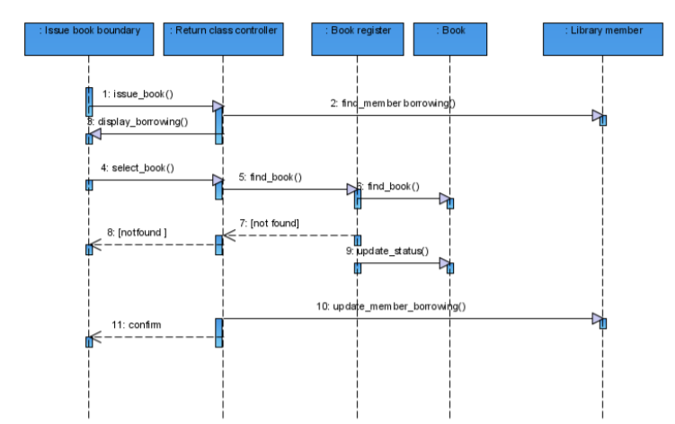
UML Diagrams (4)
Issue Book

Slide 16
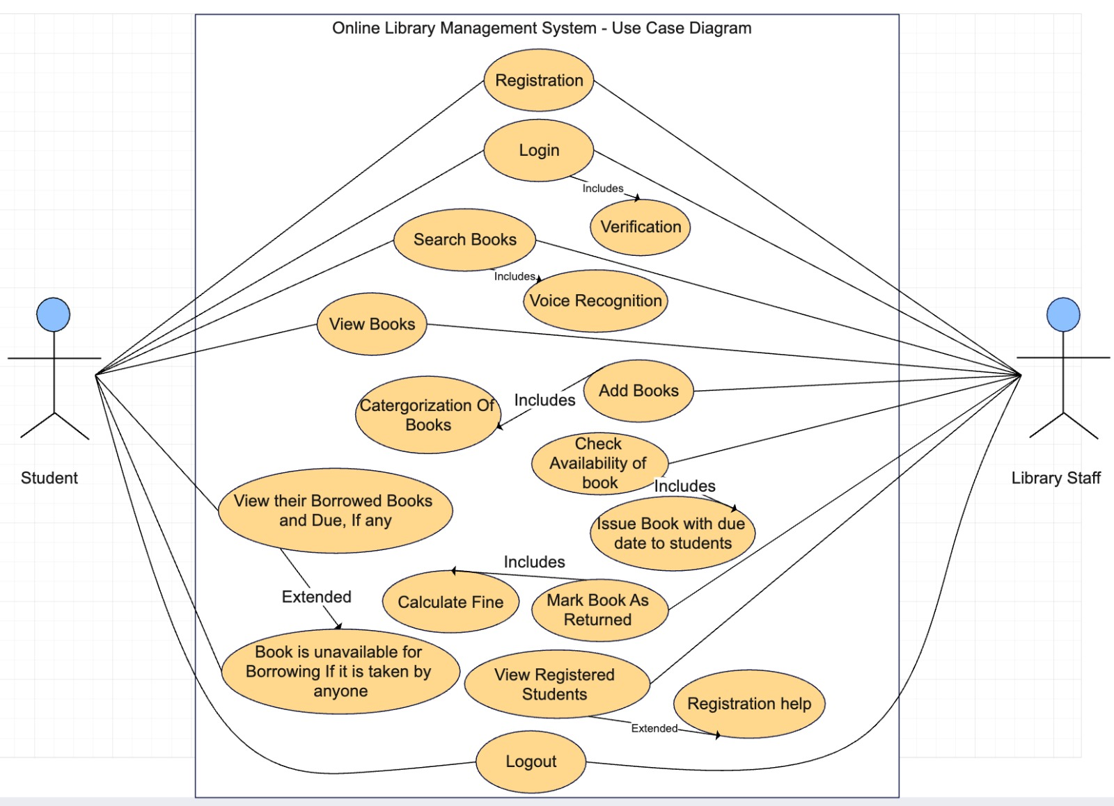
UML Diagrams (5)
Use Case Diagram - Success case

Slide 17
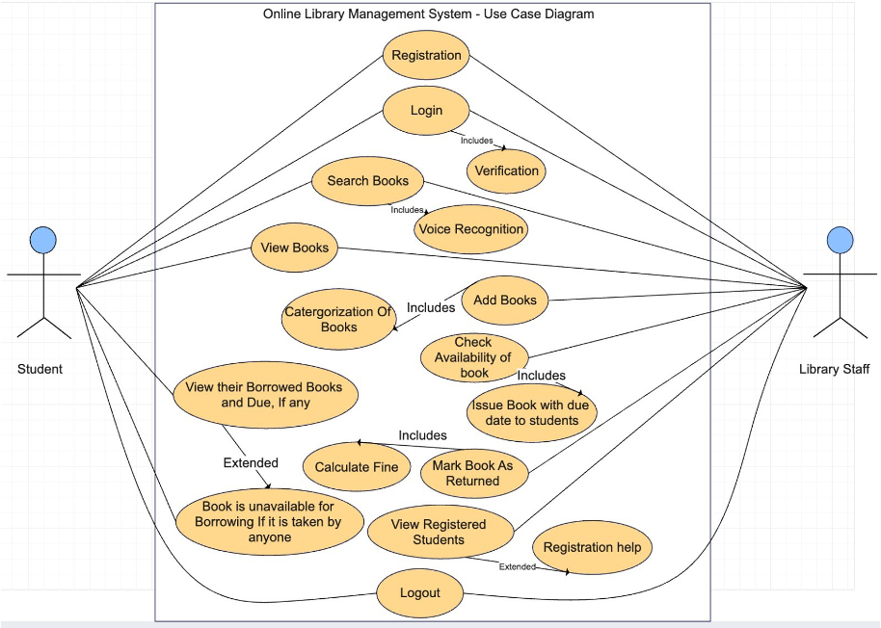
UML Diagrams (6)
Use Case Diagram - Error case

Slide 18
Implementation
The core modules of our project implementation are as follows:
➢ Admin Module
➢ Student Module
➢ Manage Books Module
➢ Expiry Date Calculation Module
➢ Fine Calculation Module
➢ Search Module
➢ Voice based search module with the help of python Speech Recognition library
➢ Web Scraping Module done with the help of Python Beautiful Soup library

Slide 19
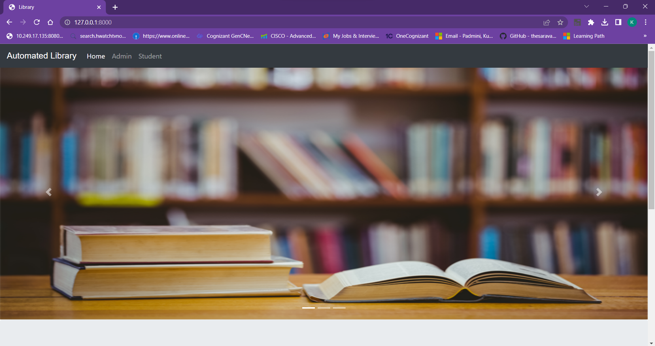
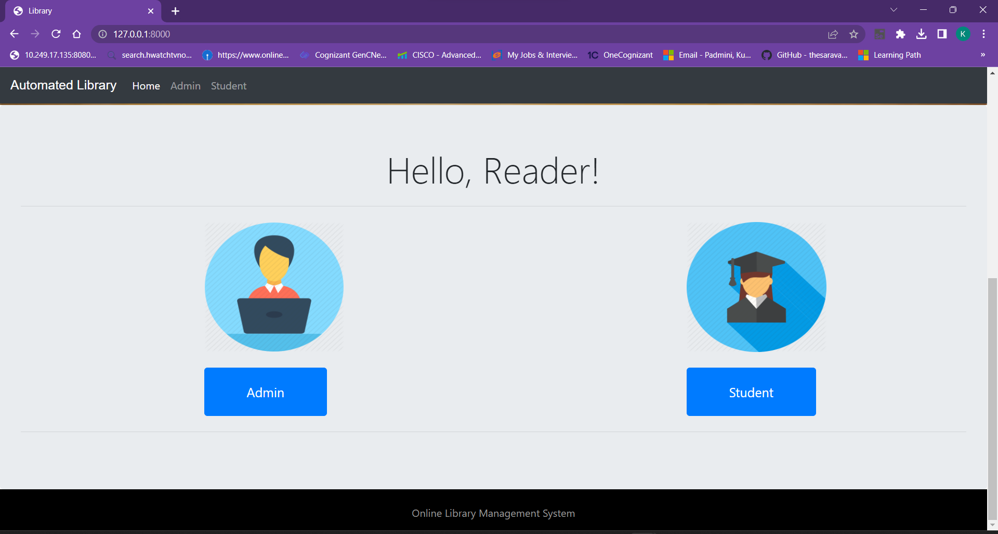
User Manual (1)
Home Page

Slide 20
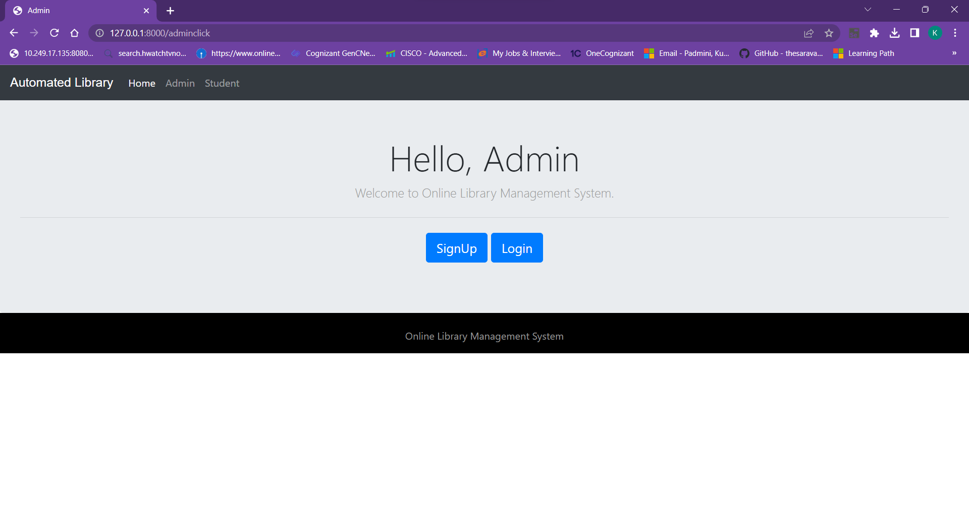
User Manual (2)
Admin Page

Slide 21
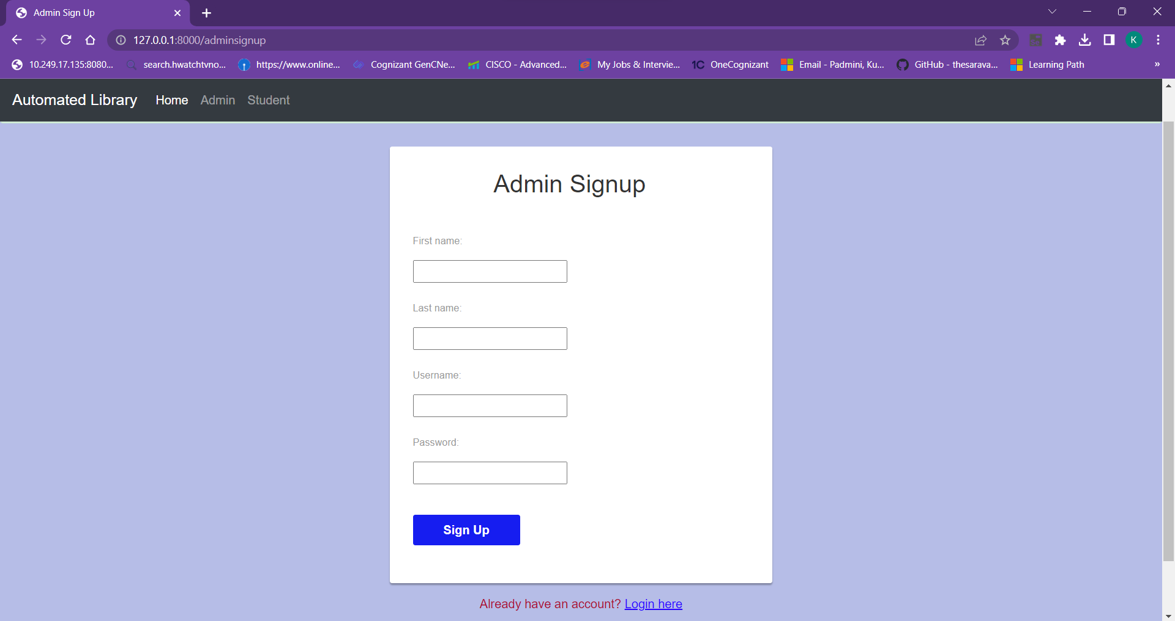
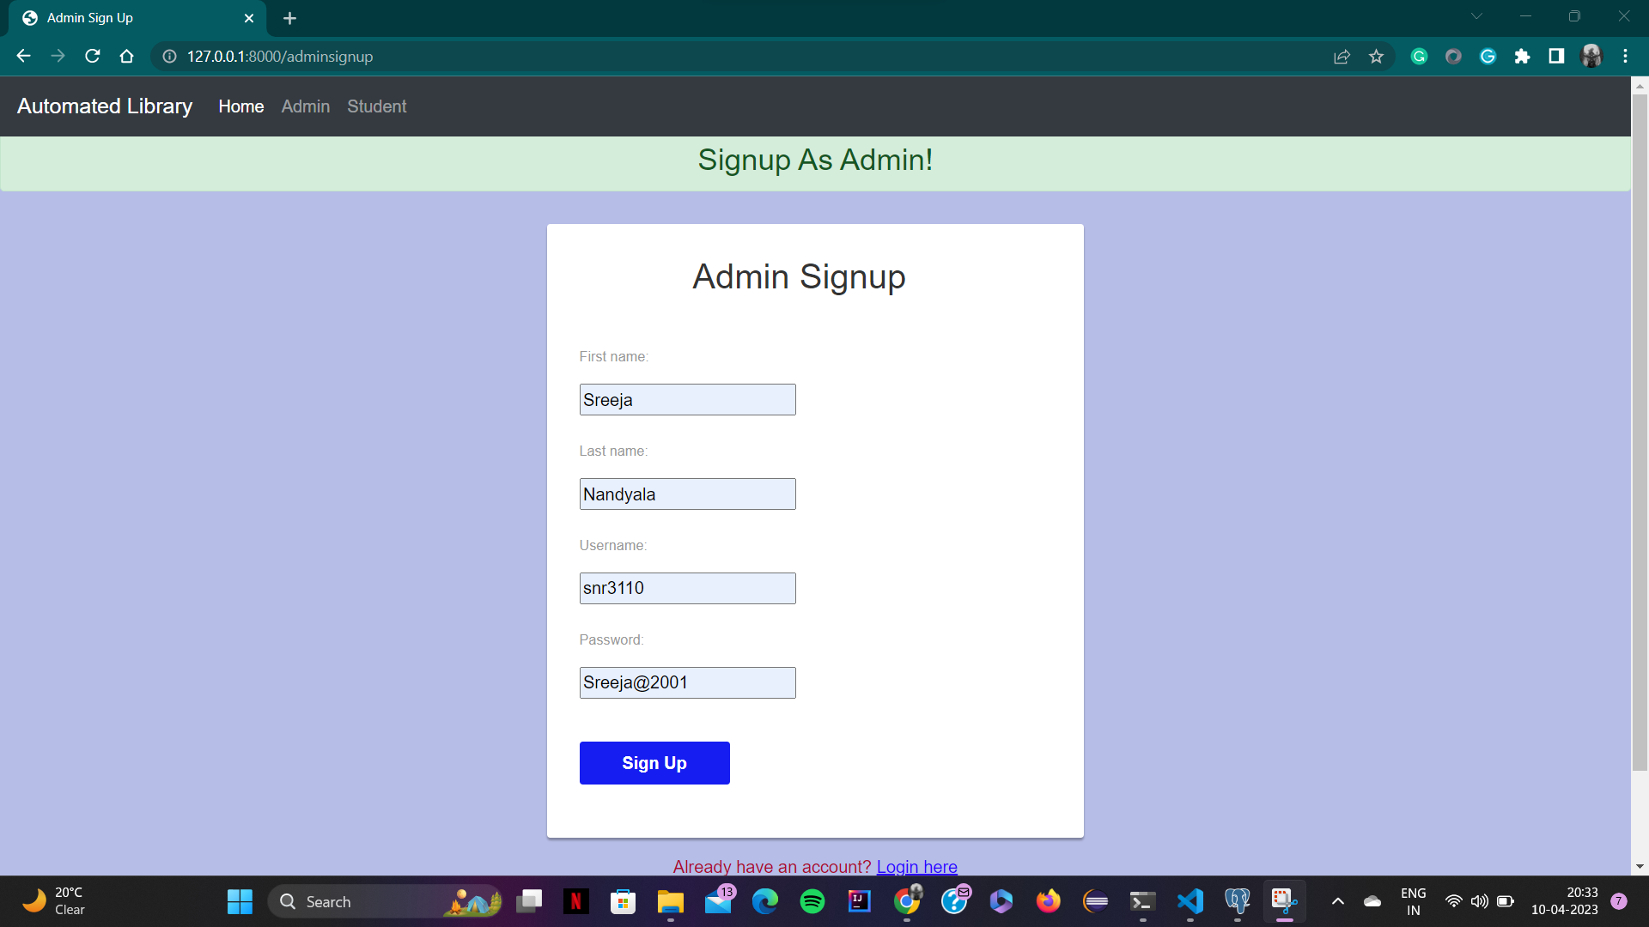
User Manual (3)
Admin Signup Page

Slide 22
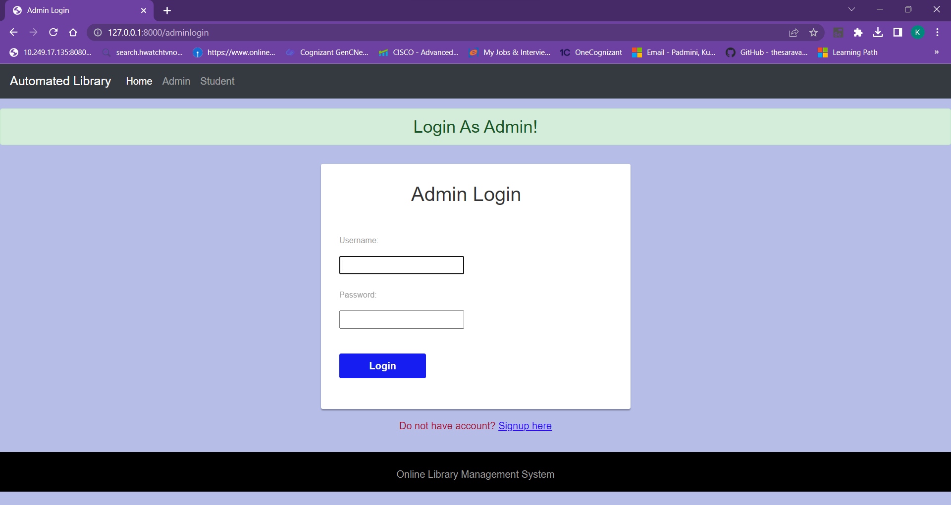
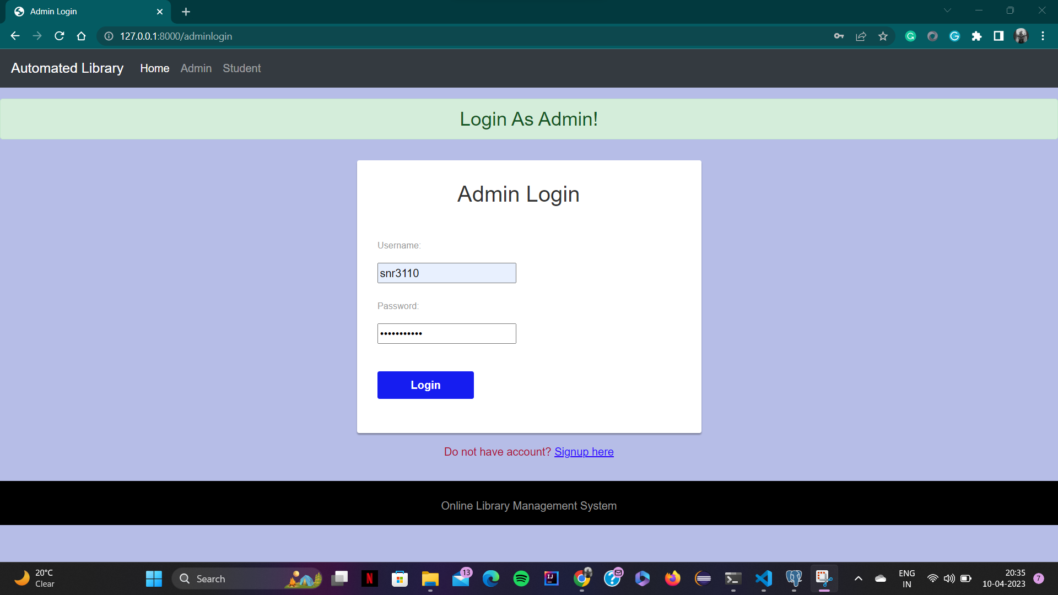
User Manual (4)
Admin Login Page

Slide 23
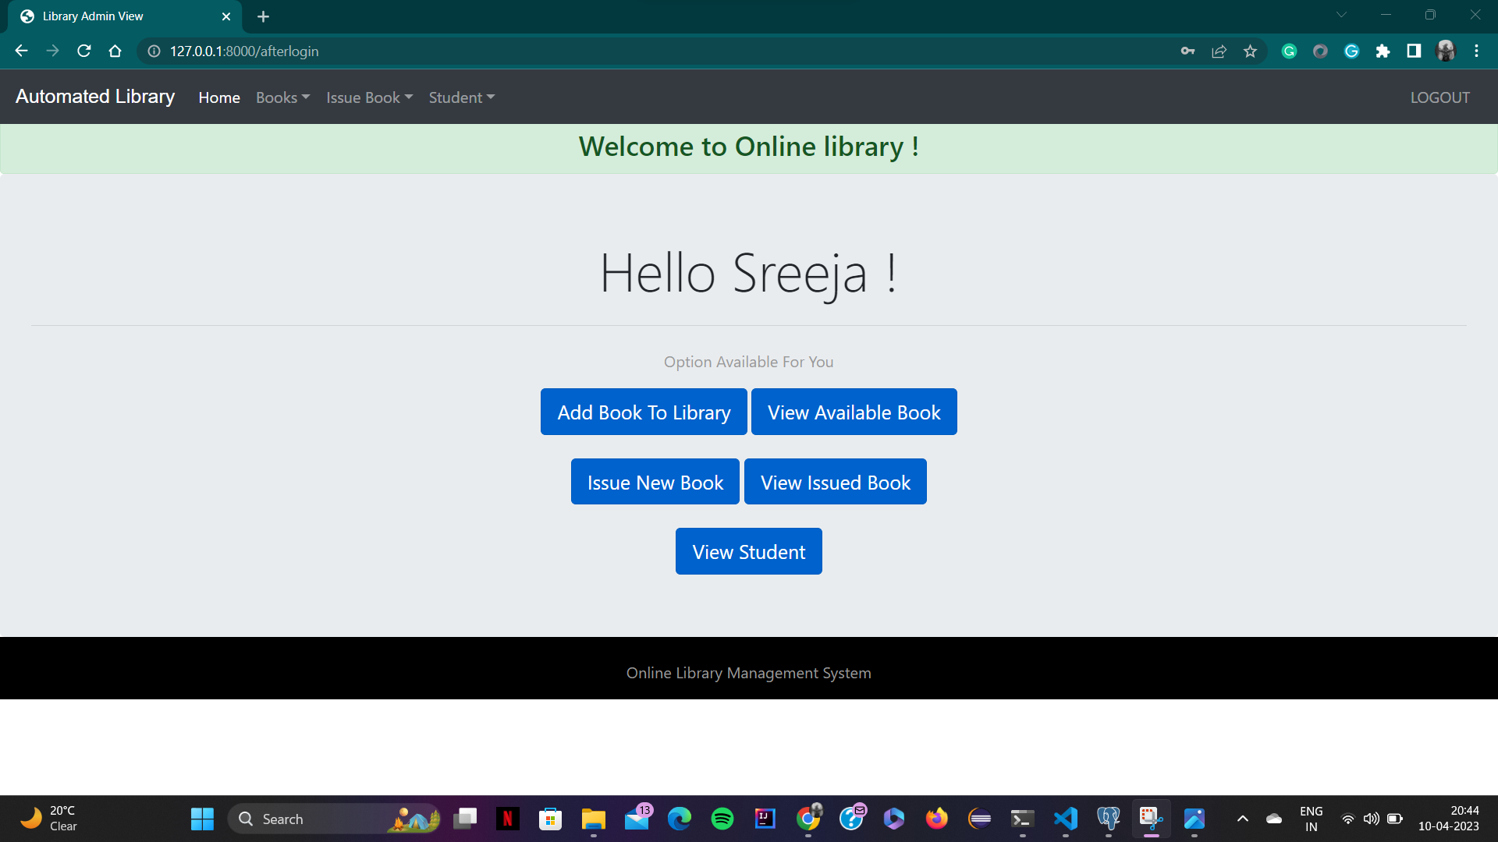
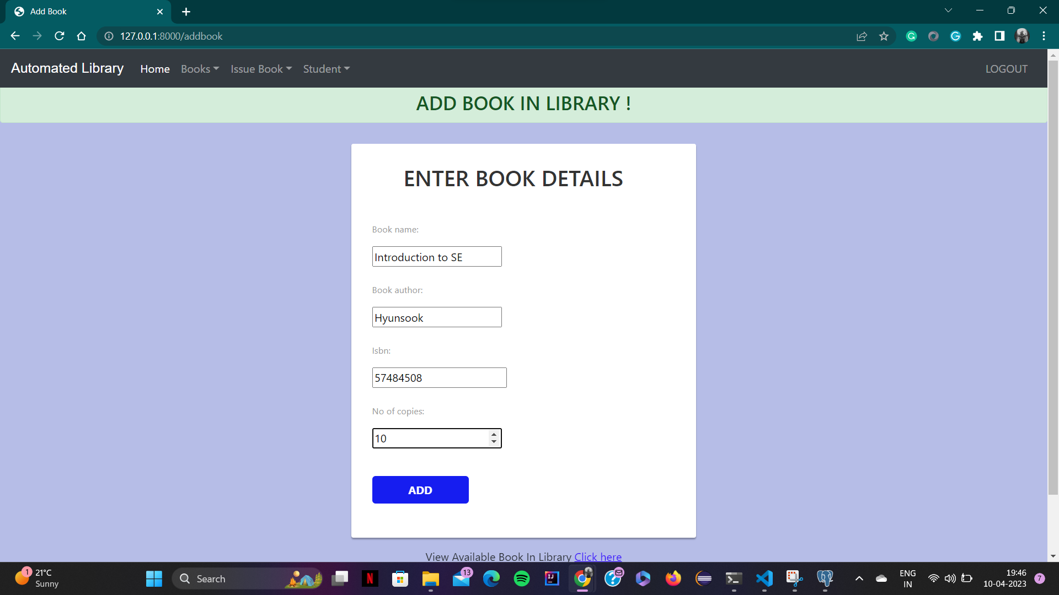
User Manual (5)
Admin Functionalities

Slide 24
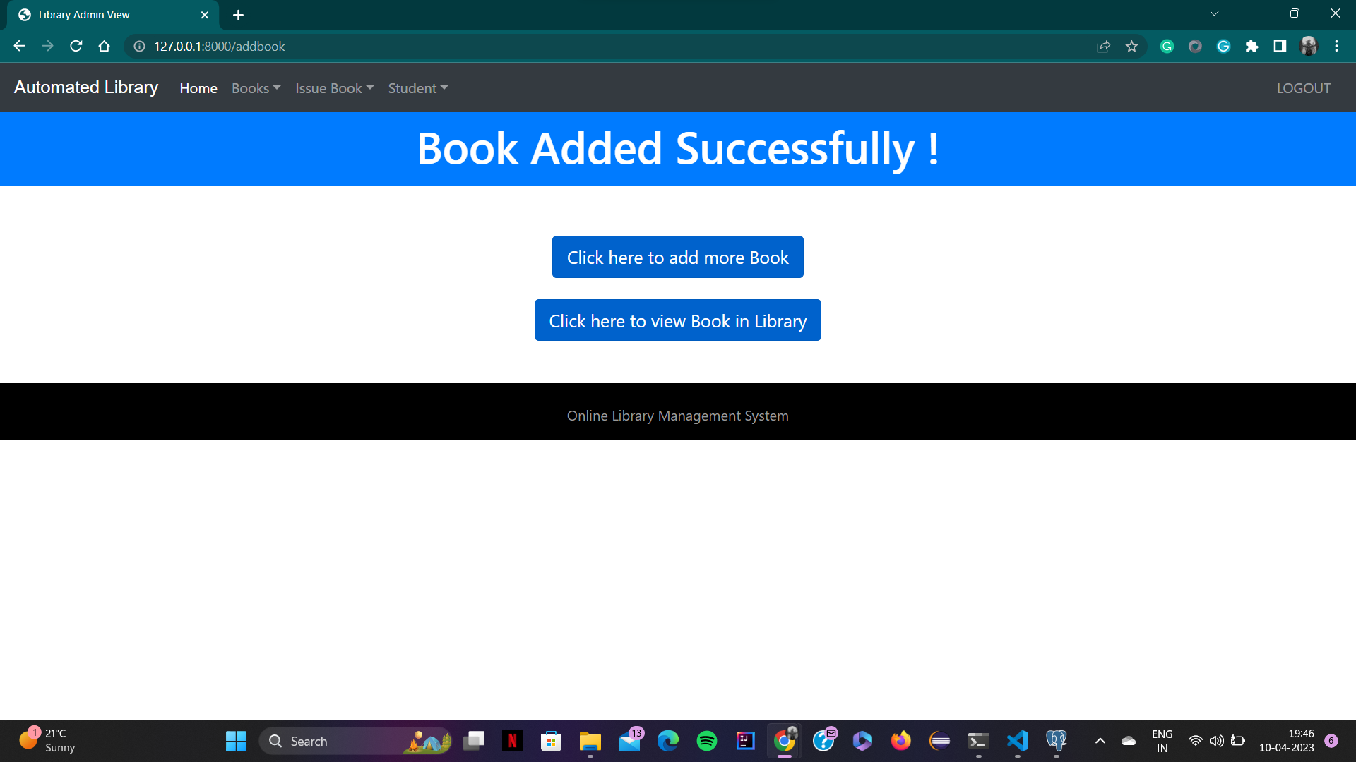
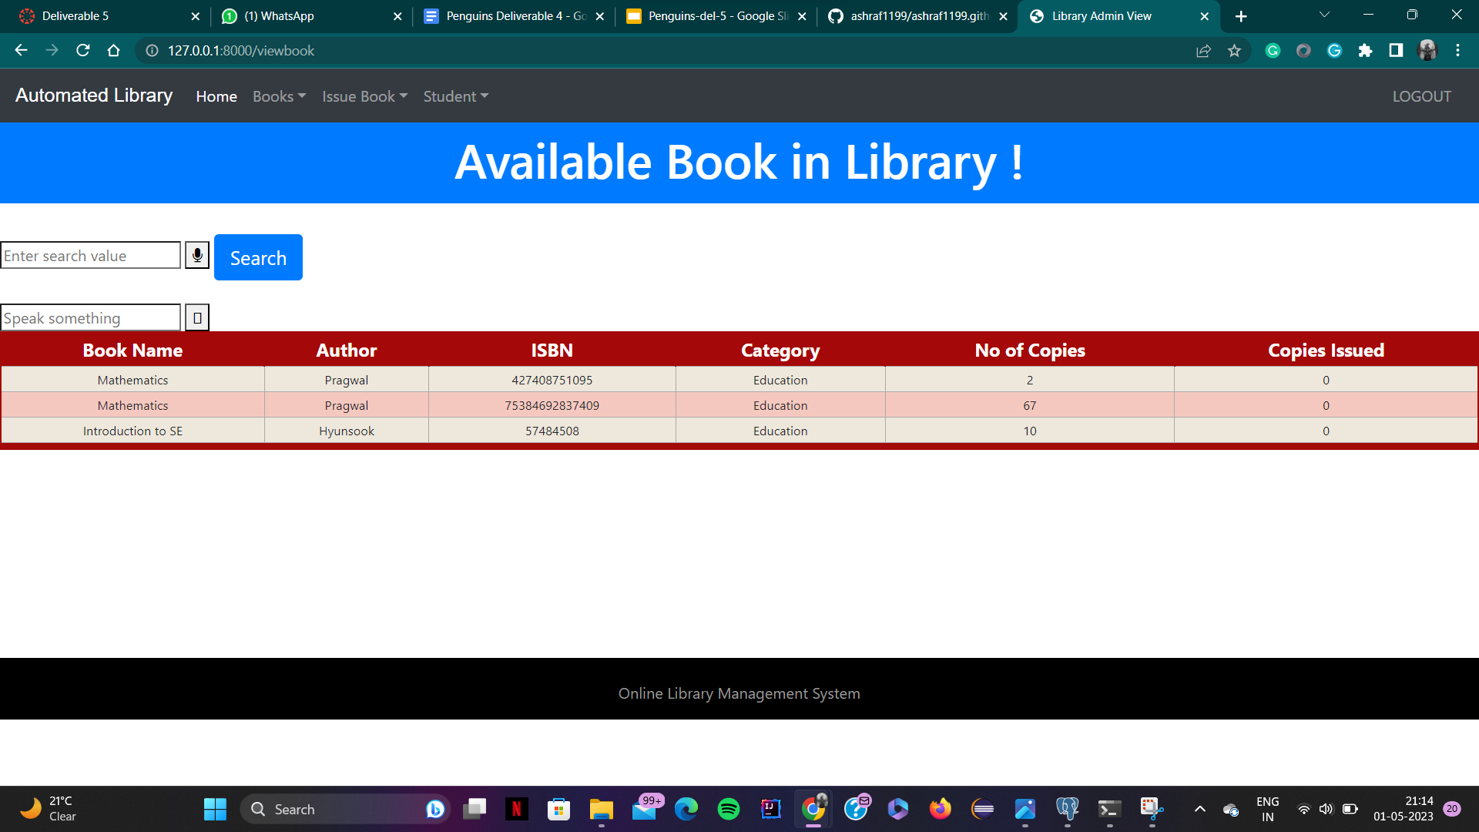
User Manual (6)
Admin Functionalities

Slide 25
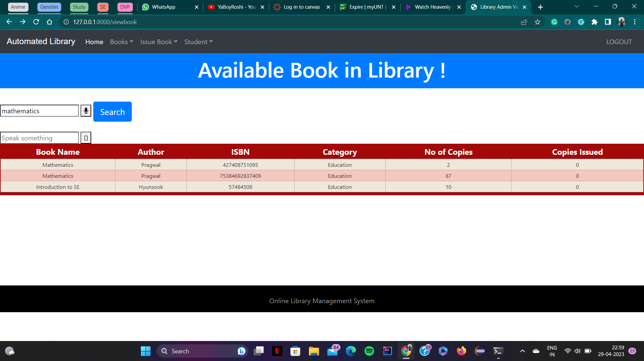
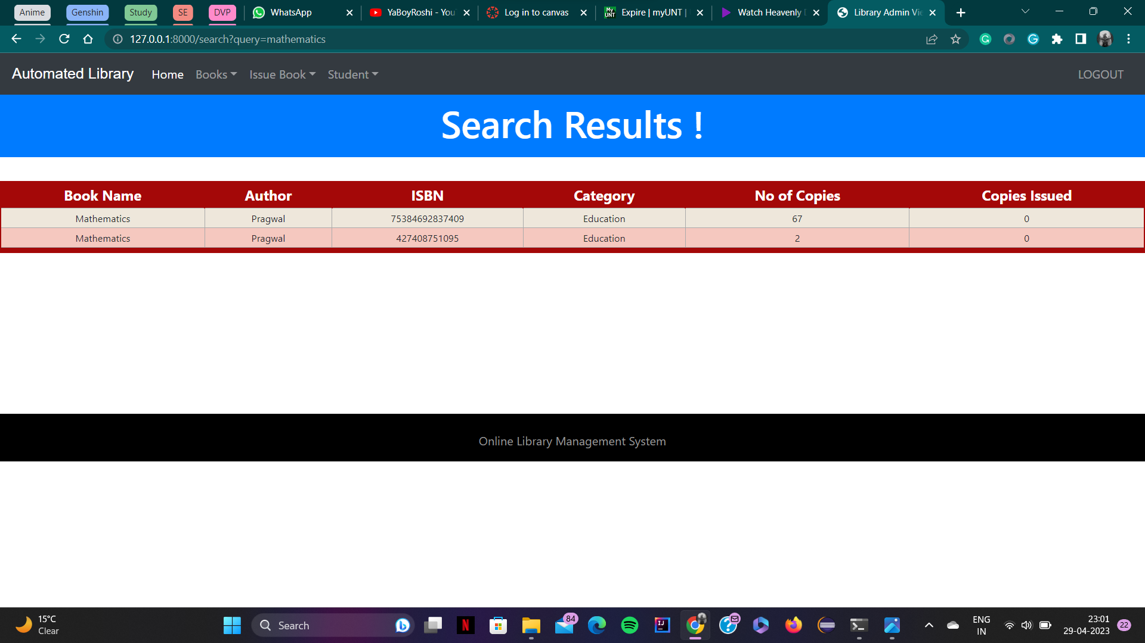
User Manual (7)
Admin Functionalities

Slide 26
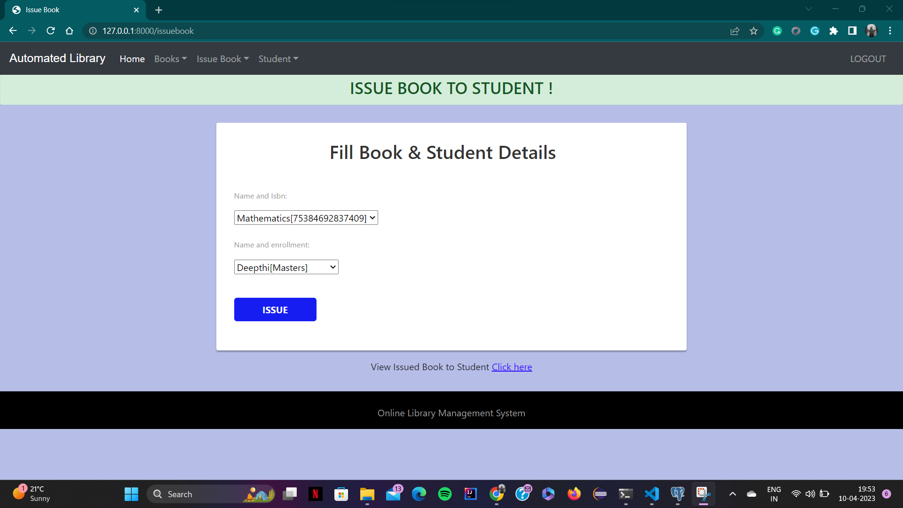
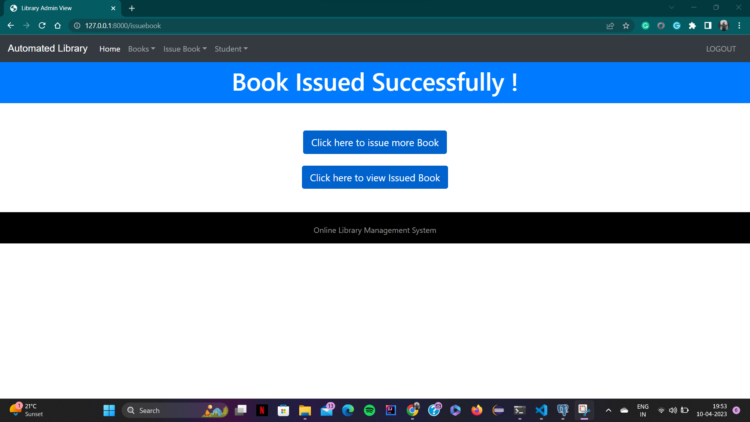
User Manual (8)
Admin Functionalities

Slide 27
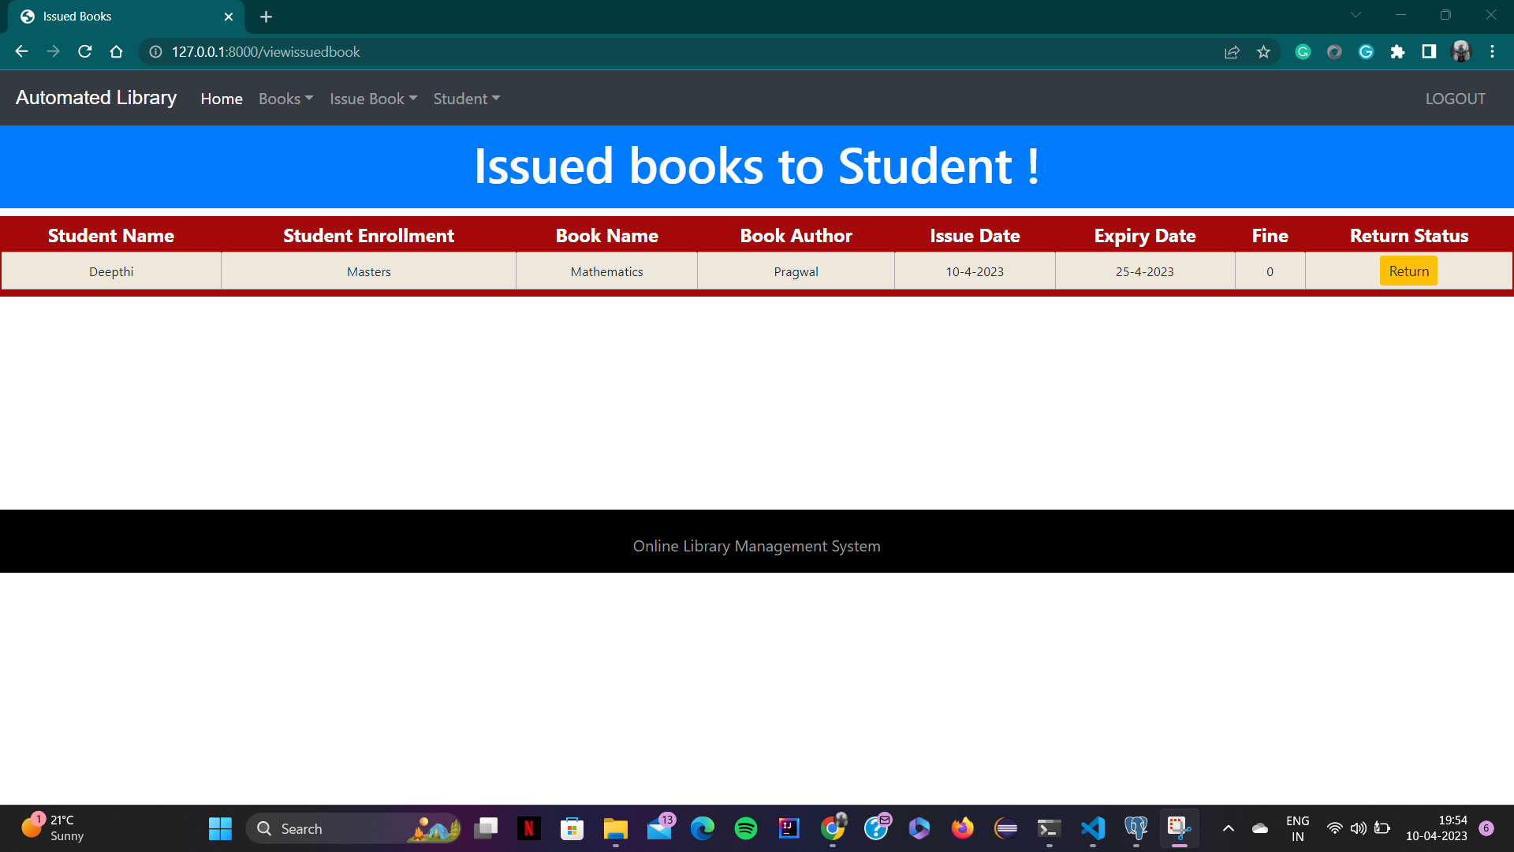
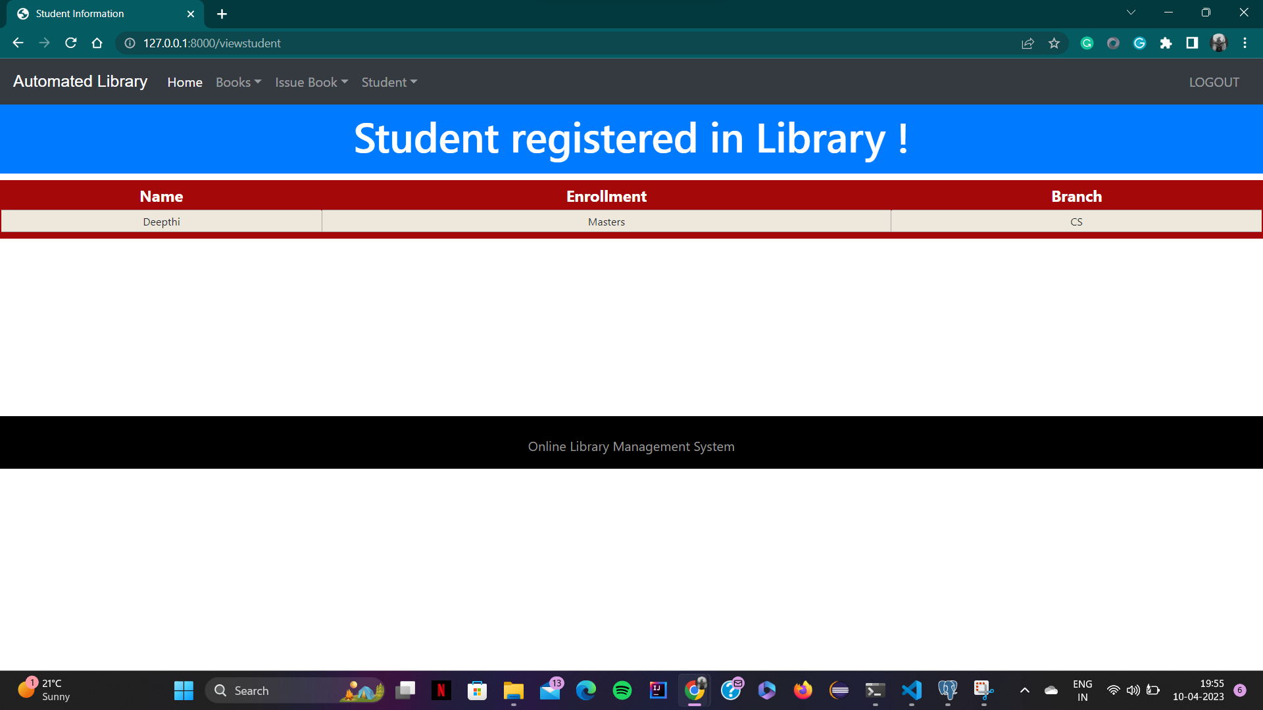
User Manual (9)
Admin Functionalities

Slide 28
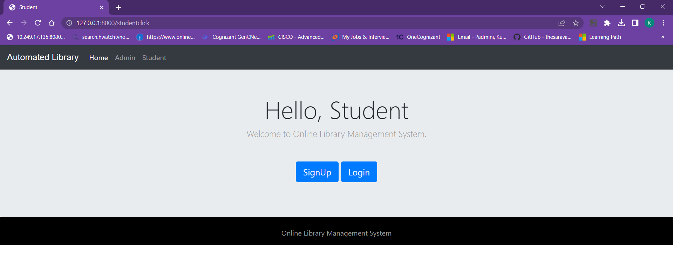
User Manual (10)
Student Page

Slide 29
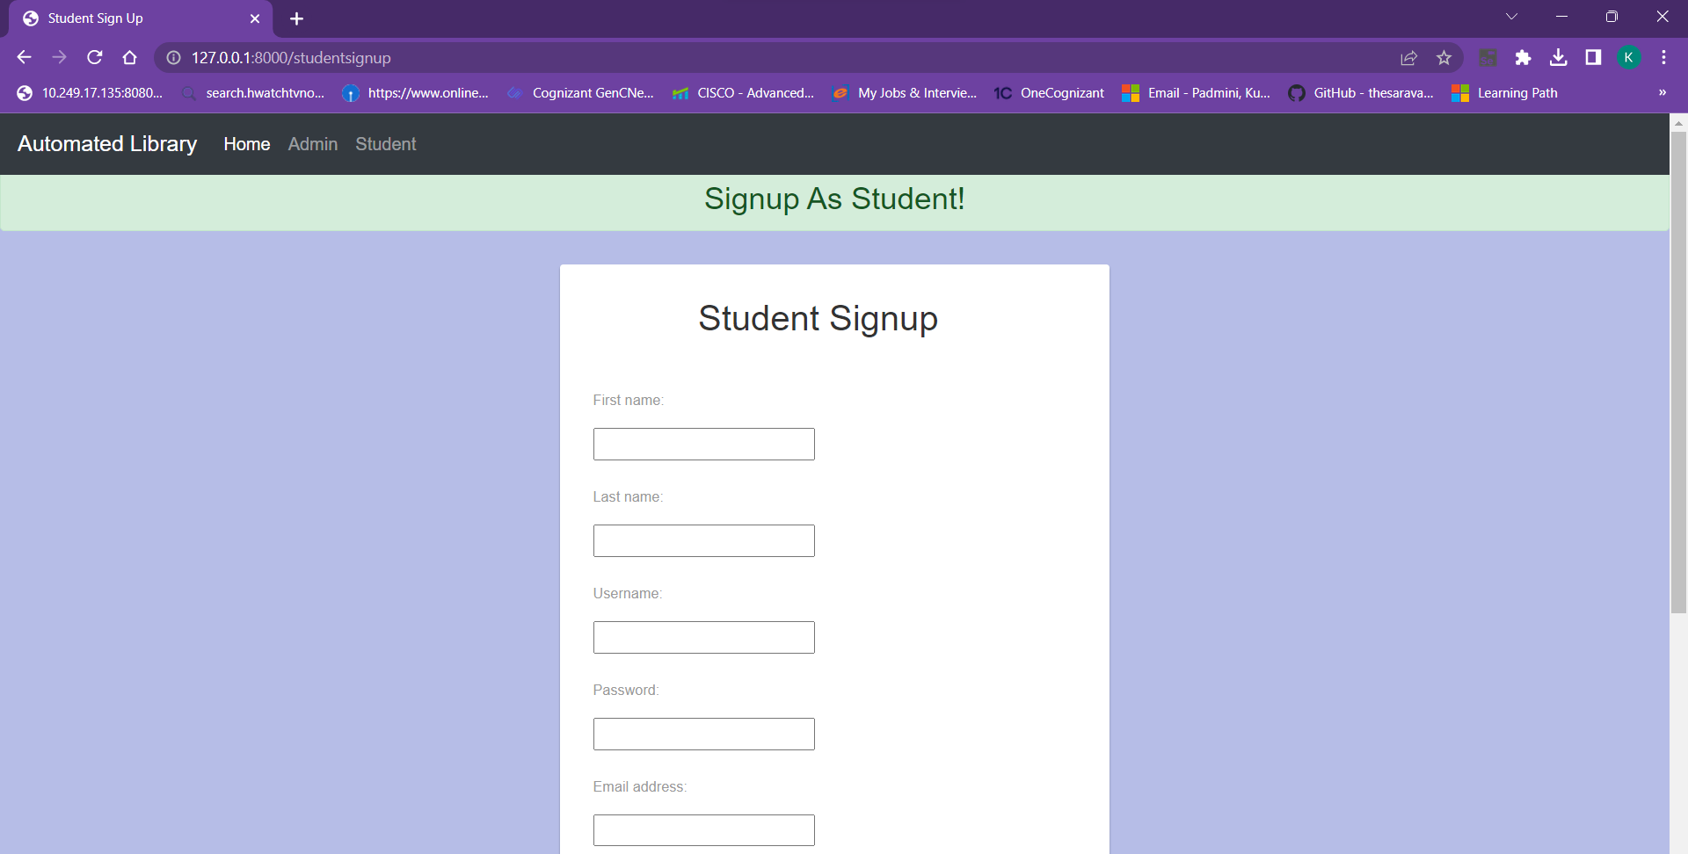
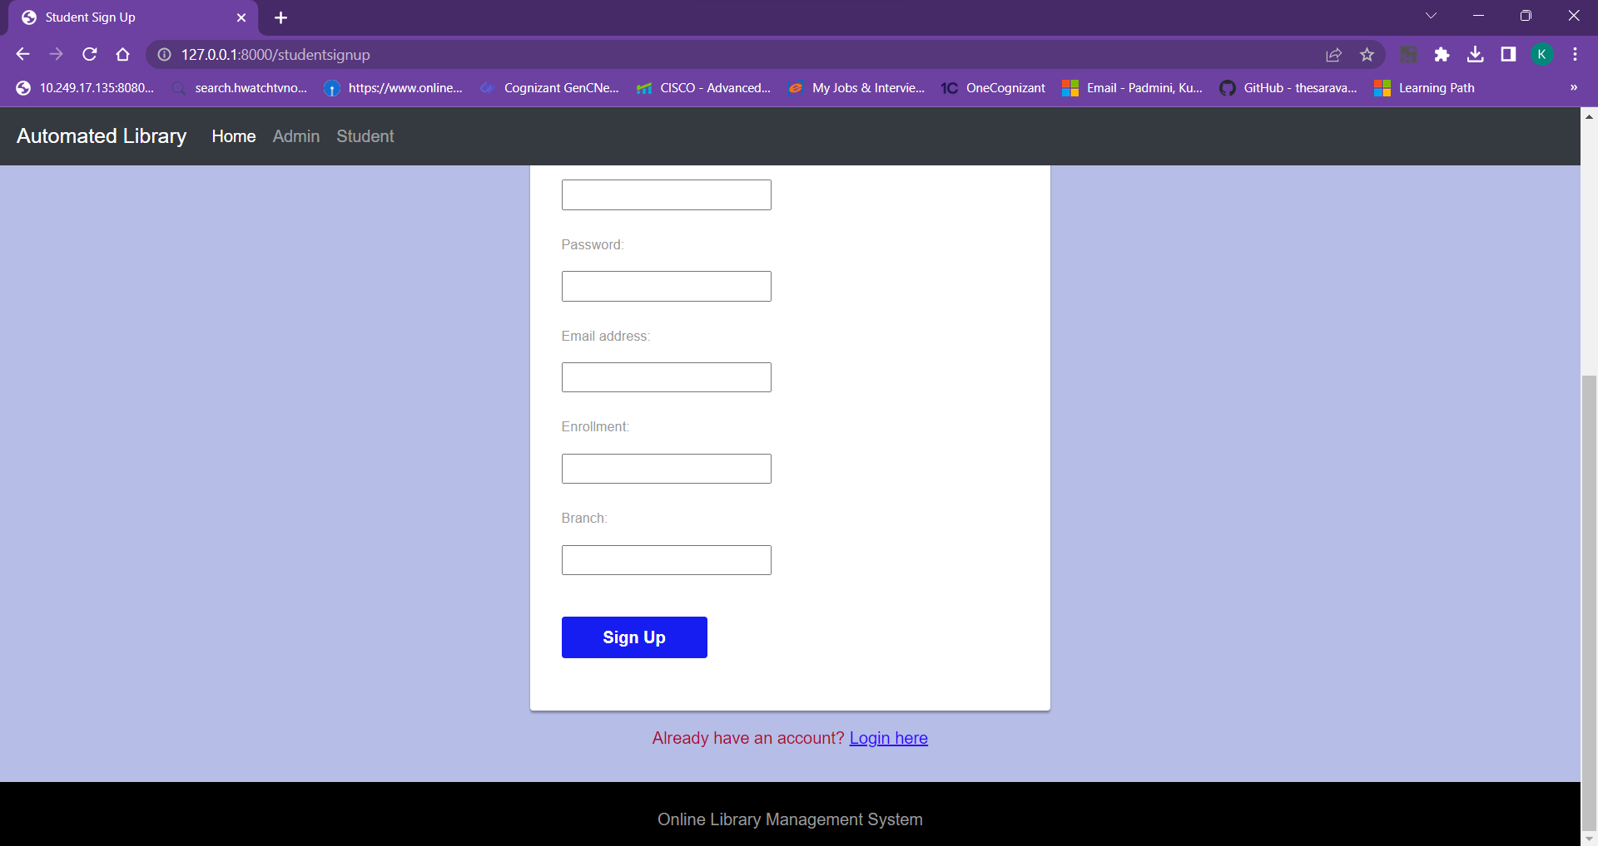
User Manual (11)
Student Signup Page

Slide 30
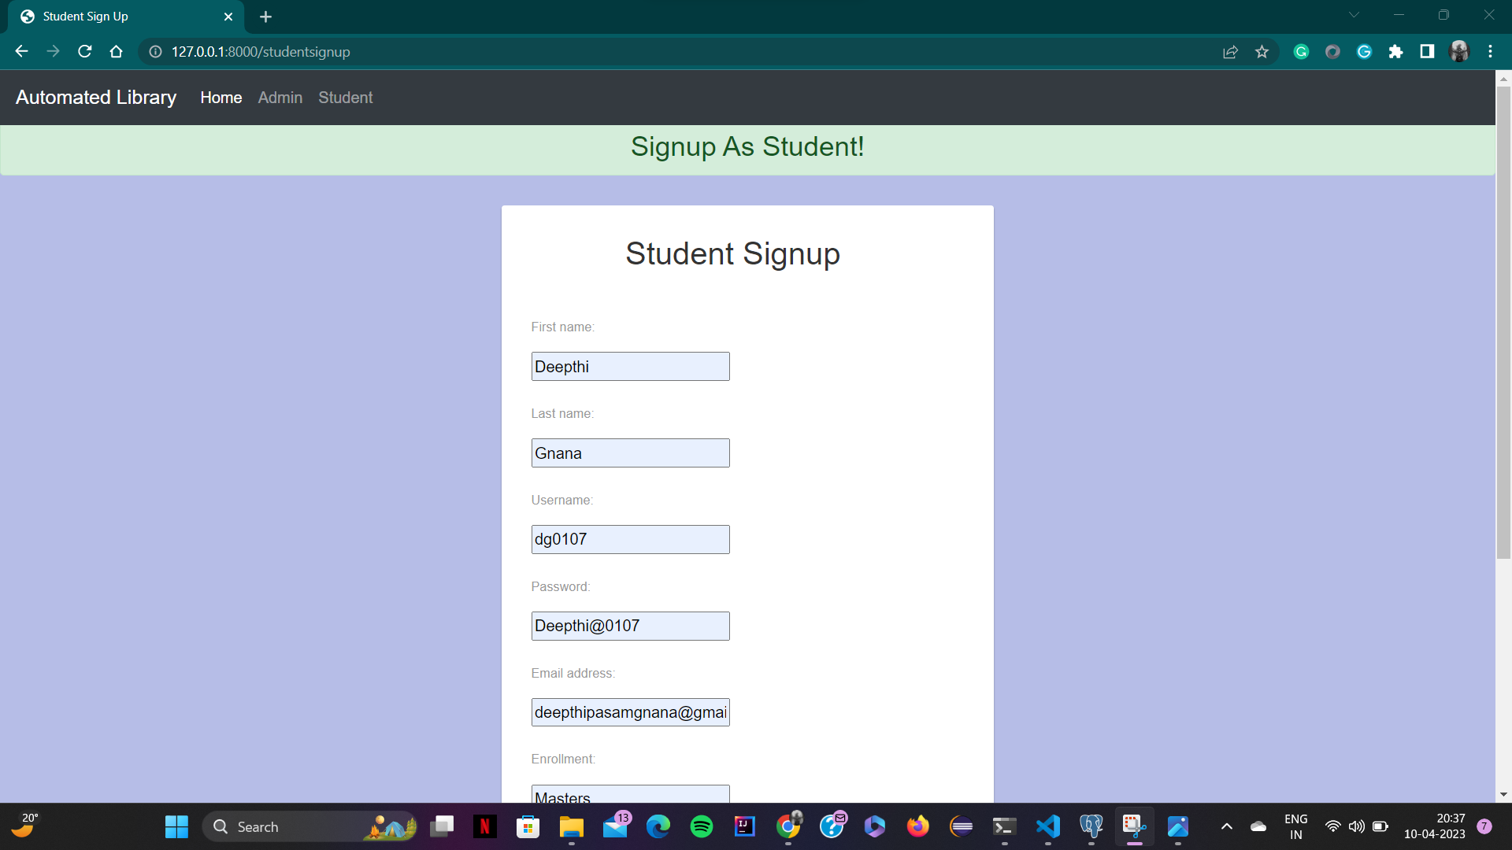
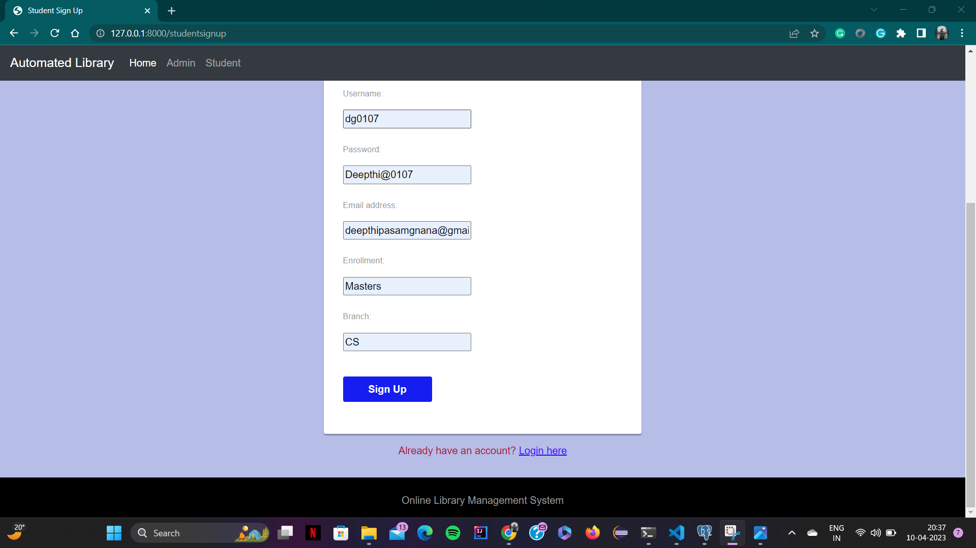
User Manual (12)
Student Signup Page

Slide 31
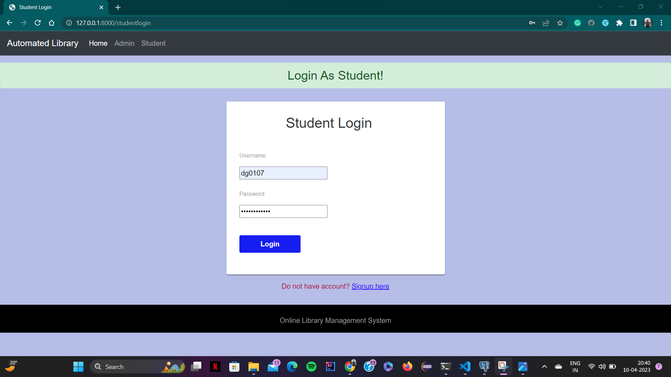
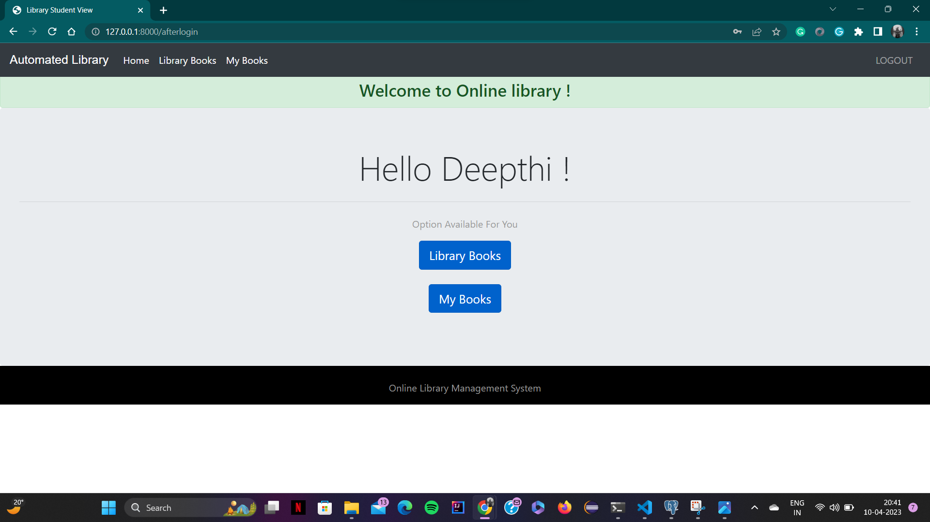
User Manual (13)
Student Login and Functionalities

Slide 32
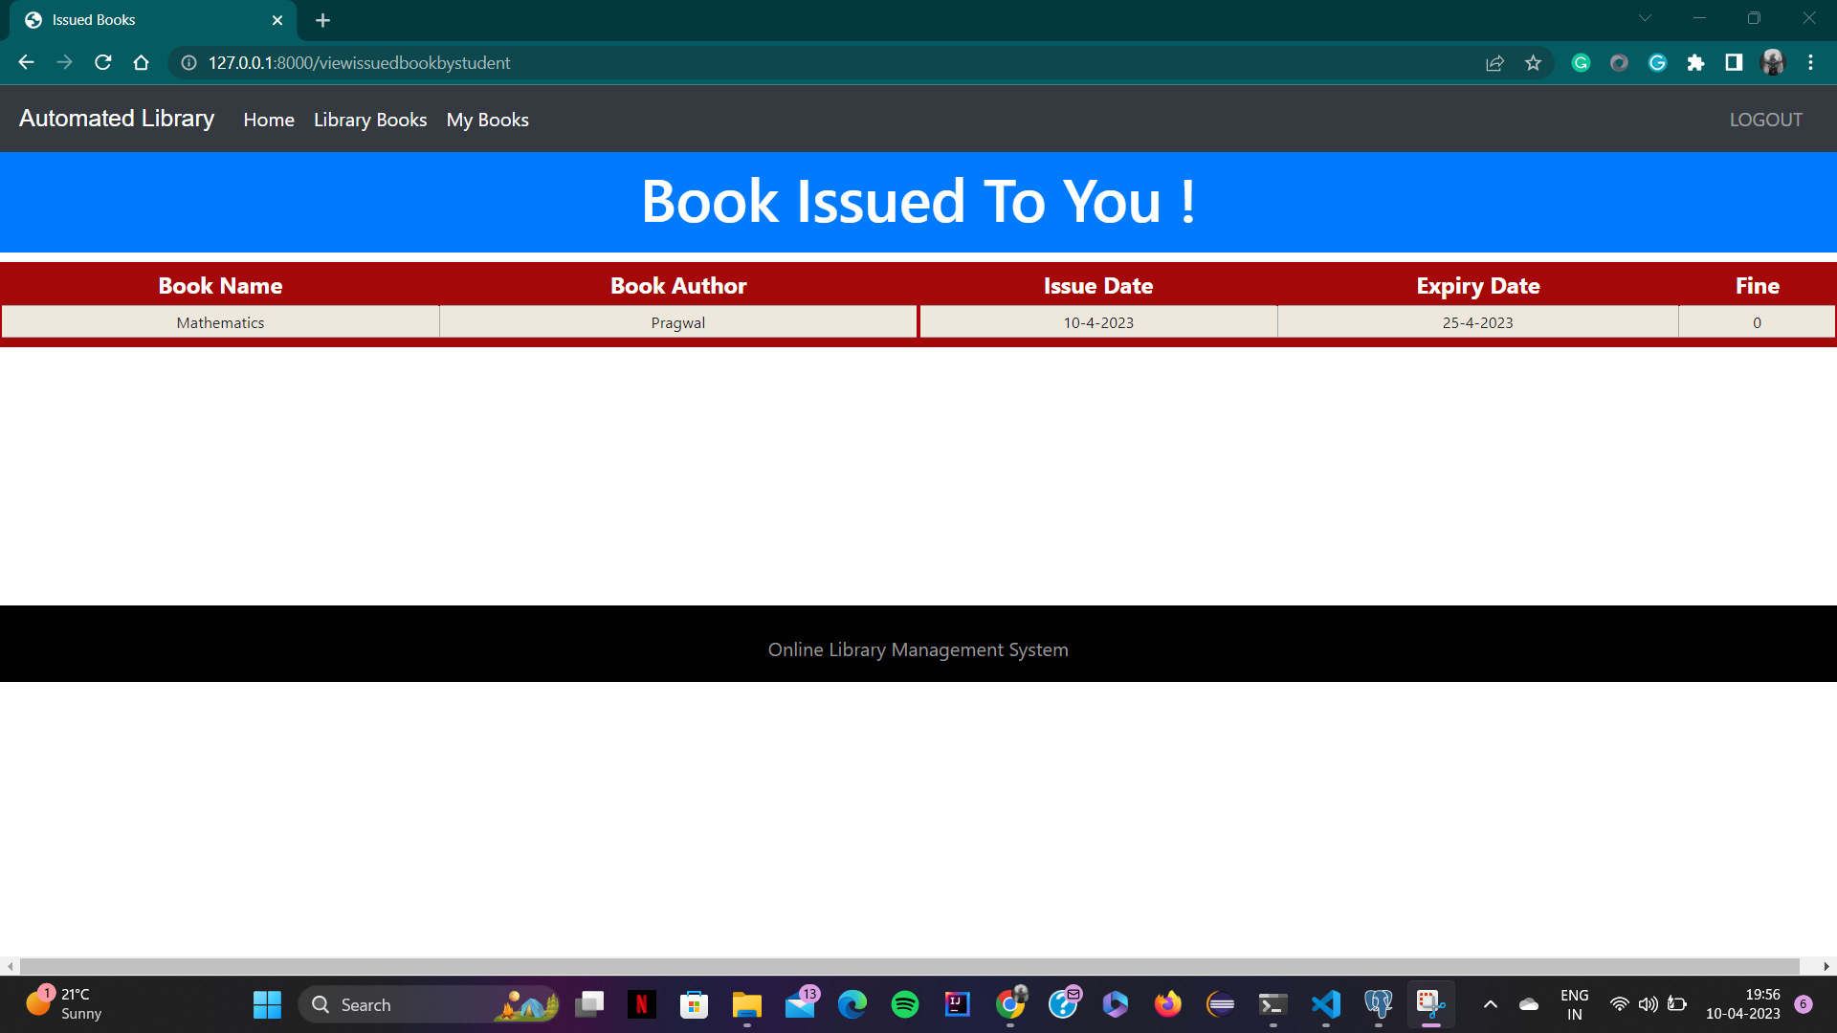
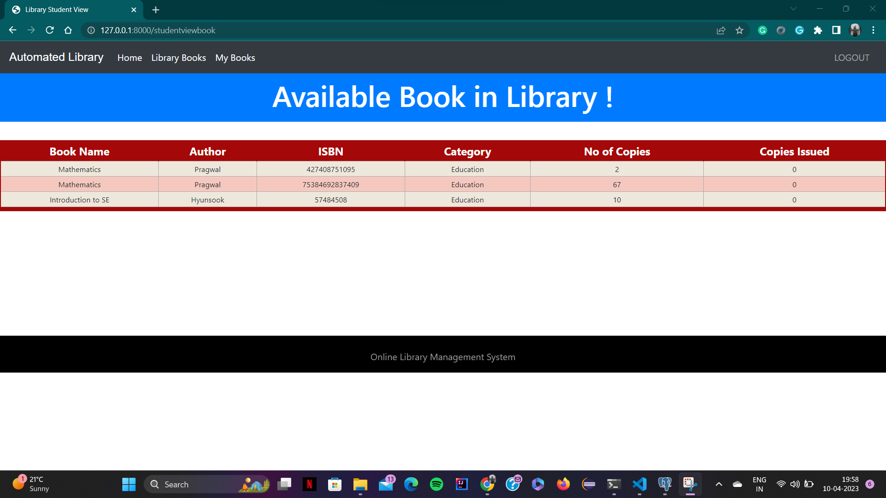
User Manual (14)
Student Functionalities

Slide 33
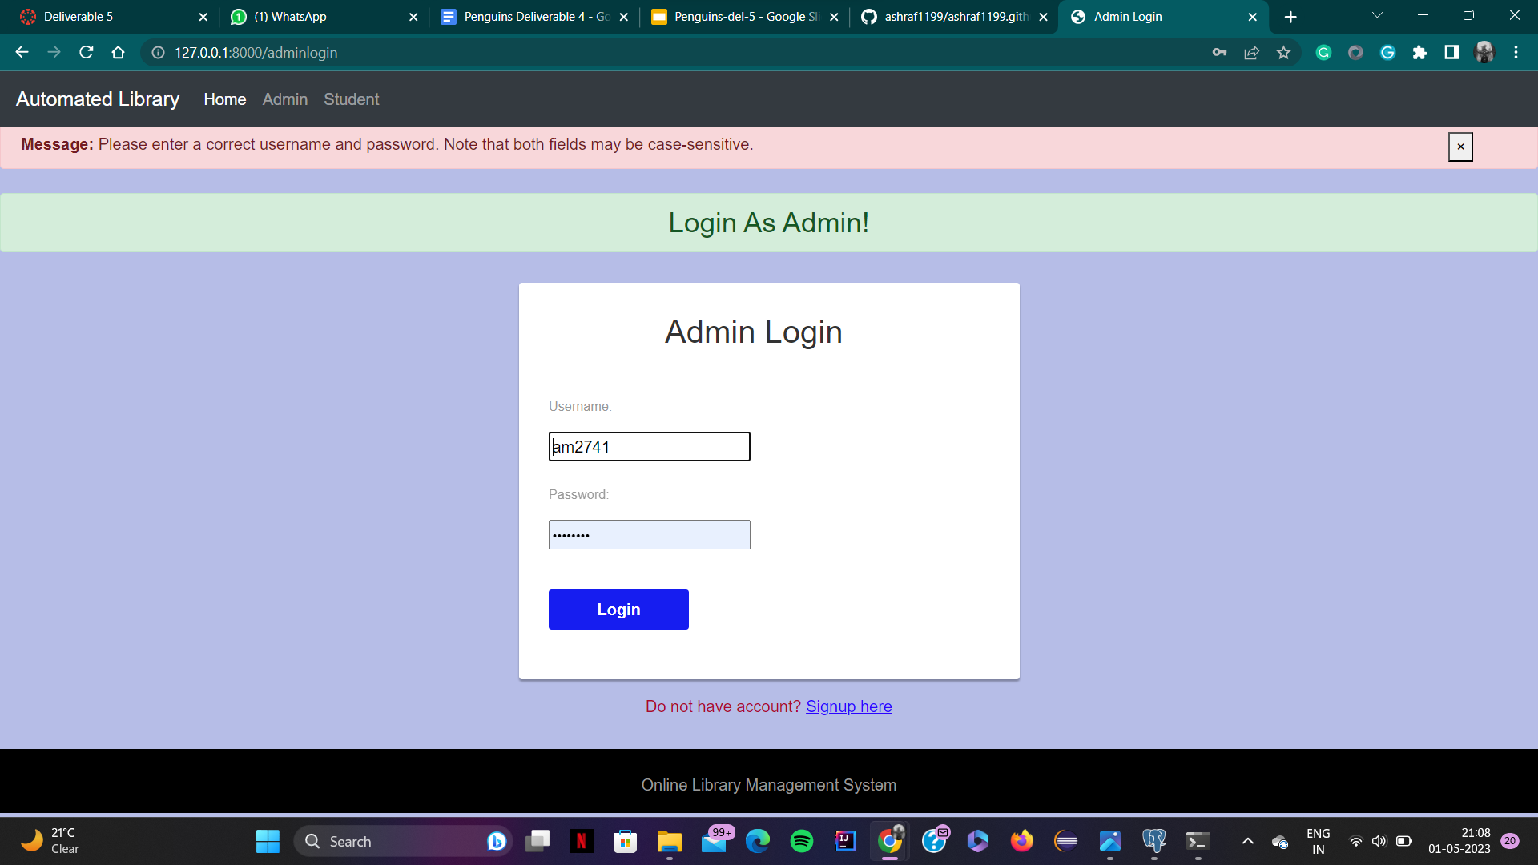

Testing & Results (1)
The above images demonstrate the system testing for the login page forms of both the student and admin.

Slide 34
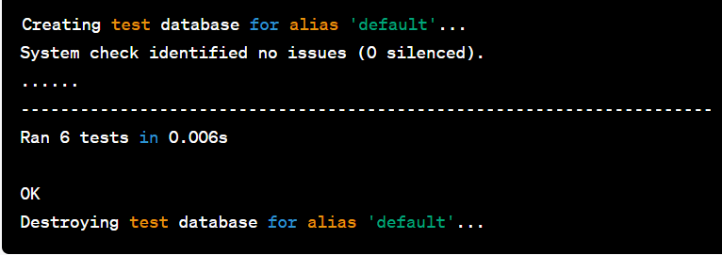
Testing & Results (2)
The above image represents the output for the unit test cases we have run for the project.

Slide 35
Feedback from peer reviews
Front end webpage improvement for simple UI - by separating the Admin and User Views.
Backend table optimisation - Normalization of
accounts_book
accounts_issuedbook
accounts_studentextra
Adding alerts for the queries runned and for user interactions for the actions performed to notify the user.
Generic library organization : Suggested to make the project generic for public use and potentially take it to market for business.

Slide 36
Code Inspection results
Notification acknowledgement for any form submission.
Code redundancy reduced as per similar UI components used.
Section retrieval was implemented for more efficient database transactions.
Categorization : They had suggested to implement categorization/ segregation of books as per branches or respective genres for ease of access to the user.

Slide 37
Limitations faced during Project
Version mismatch for various API components implemented in the project.
Had to overcome database connectivity and communication gap with for the database and the backend.
UI components positioning and visual appearance was tough to implement.
Github access and implementing code features from respective branches of team members to merge to the main branch without losing previous works.

Slide 38
Conclusion
● The Library management system process is computerized to reduce human errors and to increase the efficiency.
● The main focus of this project is to lessen human efforts.
● The maintenance of the record is made efficient, as all the record is stored in the
access databases through which data can be retrieved easily.
● Portable and flexible for further enhancement

Slide 39


